Slide 1
21AIE401 DEEP REINFORCEMENT LEARNING
Deep Reinforcement Learning for Chatbot Dialogue Optimization
Project Presentation
Group Members:
Nehith Sai Vemulapalli - AM.EN.U4AIE20053
Paladugula Pruthvi - AM.EN.U4AIE20054

Slide 2
Introduction
In the domain of Natural Language Processing (NLP), chatbots serve as a significant medium for human-computer interaction. The quality of this interaction is contingent on the chatbot capacity to provide coherent and contextually appropriate responses. Traditional chatbot systems, trained using supervised learning, often lack adaptability and struggle with novel inputs. This project employs Deep Reinforcement Learning (DRL) to optimize chatbot dialogues, aiming to enhance the chatbot adaptability and improve the user experience. Through DRL, the chatbot learns to generate more meaningful responses by receiving feedback over time, allowing for a more natural and dynamic conversation flow.

Slide 3
Related Works
a. Li, J., Monroe, W., Ritter, A., Galley, M., Gao, J., & Jurafsky, D. (2016): Their paper, "Deep Reinforcement Learning for Dialogue Generation", indeed introduced a DRL-based method for dialogue generation. Their approach aimed at addressing the "safe responses" issue in chatbot dialogues, making conversations more engaging and diverse.
b. Dhingra, B., Li, L., Li, X., Gao, J., Chen, Y. N., Ahmed, F., & Deng, L. (2016): In the research titled "End-to-End Reinforcement Learning of Dialogue Agents for Information Access", they examined reinforcement learning for information-seeking chatbots.
c. Liu, B., & Lane, I. (2017): Their paper, "Iterative Policy Learning in End-to-End Trainable Task-Oriented Neural Dialog Models", discusses an iterative policy learning approach for task-oriented dialogues.
d. Lewis, M., Yarats, D., Dauphin, Y., Parikh, D., & Batra, D. (2017): In the study titled "Deal or No Deal? End-to-End Learning for Negotiation Dialogues", they leveraged end-to-end deep reinforcement learning to train dialogue agents to negotiate.
e. Wolf, T., Chaumond, J., & Delangue, C. (2019): Their work, associated with the "Hugging Face" community, has been groundbreaking in terms of incorporating transformers and other advanced architectures for NLP tasks, including chatbots.

Slide 4
Methodology
The code is used for creating and training a Deep Q-Network (DQN) agent for chatbot dialogue optimization. The salient points of the code are as follows:
Environment and Setup: The environment simulates user interactions with the chatbot, providing scenarios for dialogue decision-making.
Deep Q-Network (DQN) Framework: The DQNAgent class implements the DQN algorithm to estimate optimal dialogue responses.
Learning and Adaptation: The agent learns from user interactions, updating its policy to improve dialogue responses over time.
Monitoring and Debugging: The agent's learning progress can be monitored to understand its behavior and make necessary adjustments.

Slide 5
Methodology (contd.)
The main methodology of the project is divided into three main functions as follows:
RLStep: This function performs a step of reinforcement learning, taking in the input and target variables, encoders, decoder, and other parameters to generate a response and calculate the loss.
calculate_rewards: This function is responsible for calculating rewards based on the criteria mentioned earlier. The rewards are calculated using the ease of answering, information flow, and semantic coherence of the generated responses.
trainRLIters: This function is responsible for training the model over multiple iterations. It updates the model parameters based on the rewards calculated in the calculate_rewards function.

Slide 6
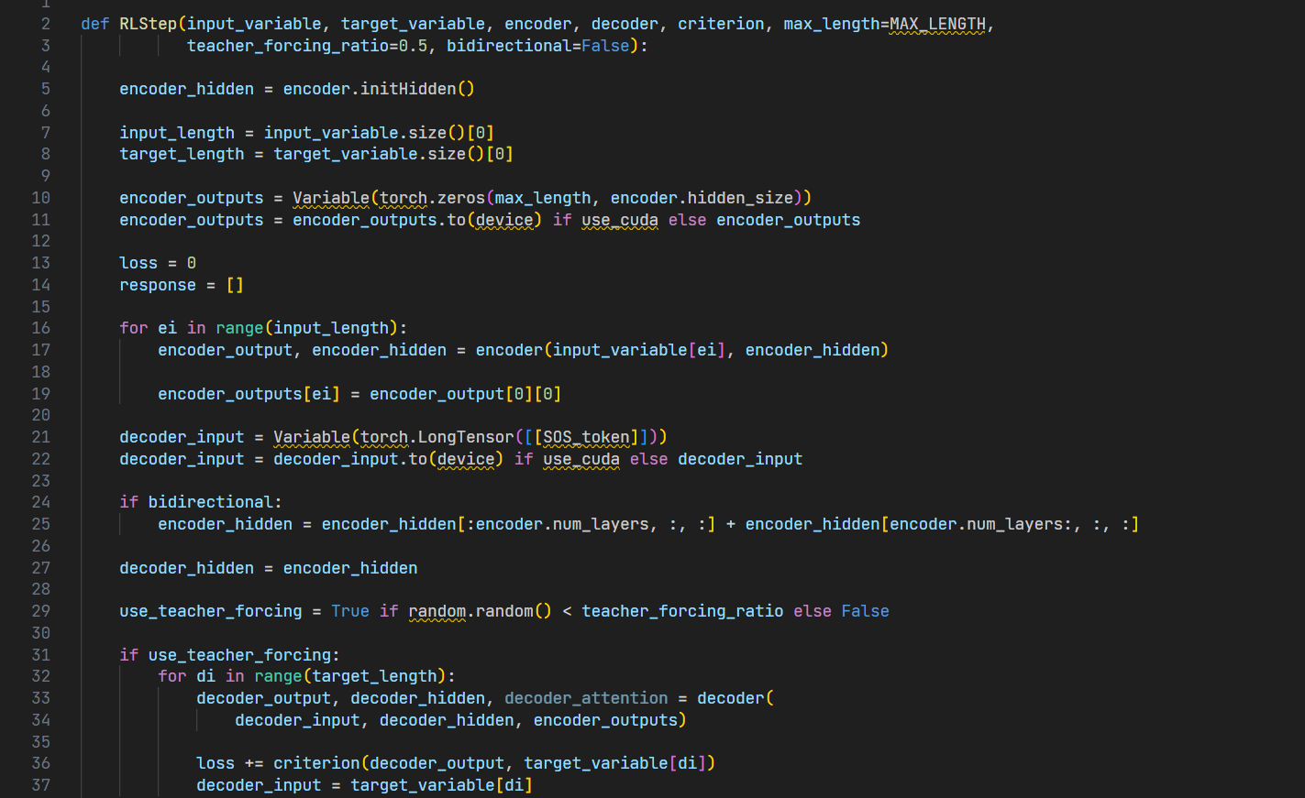
RLStep

Slide 7
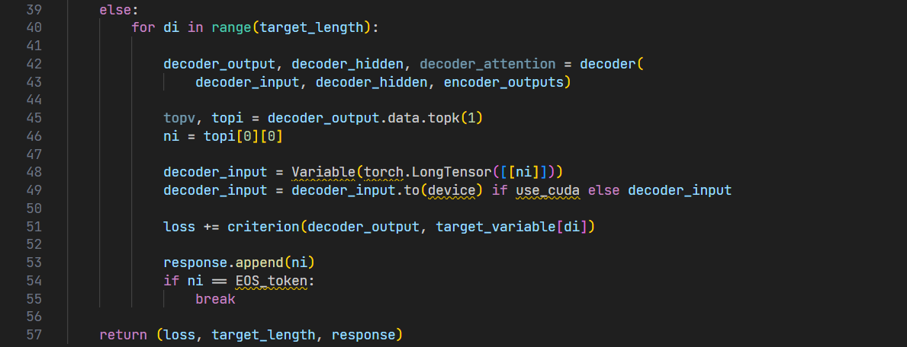

Slide 8
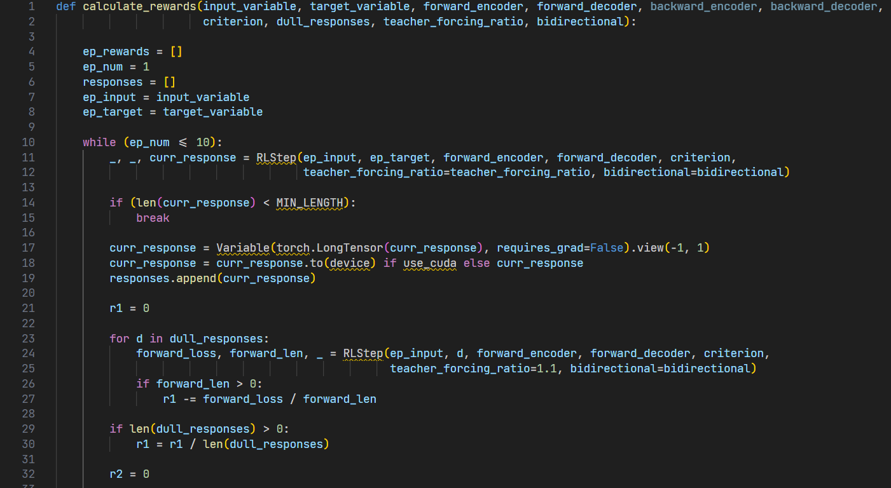
calculate_rewards

Slide 9
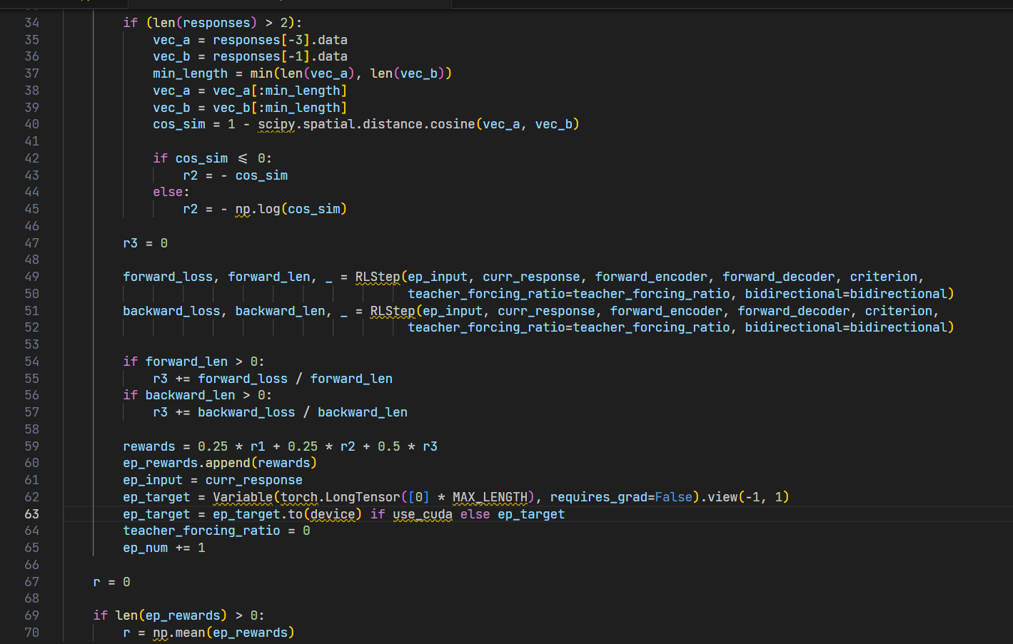

Slide 10
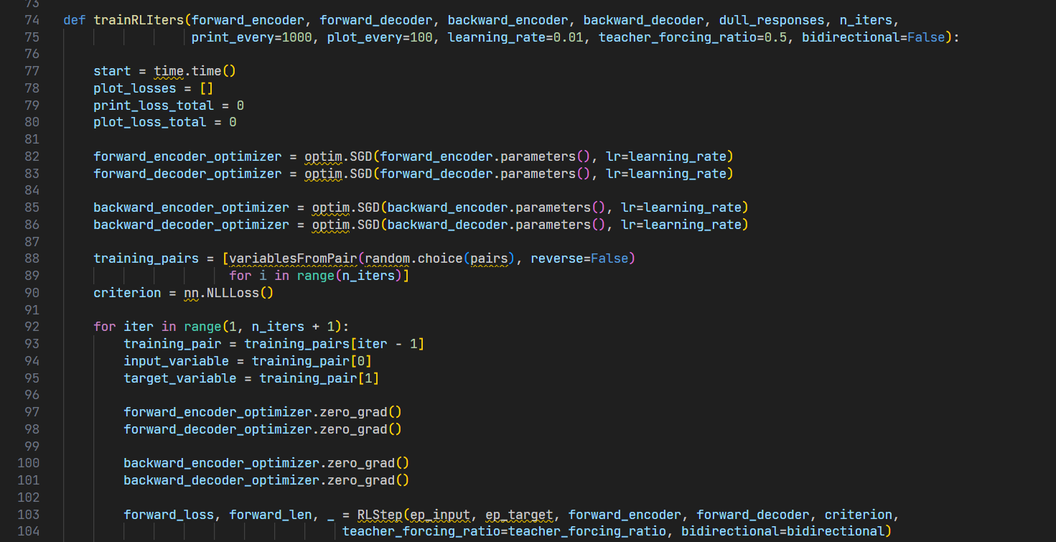
trainRLIters

Slide 11
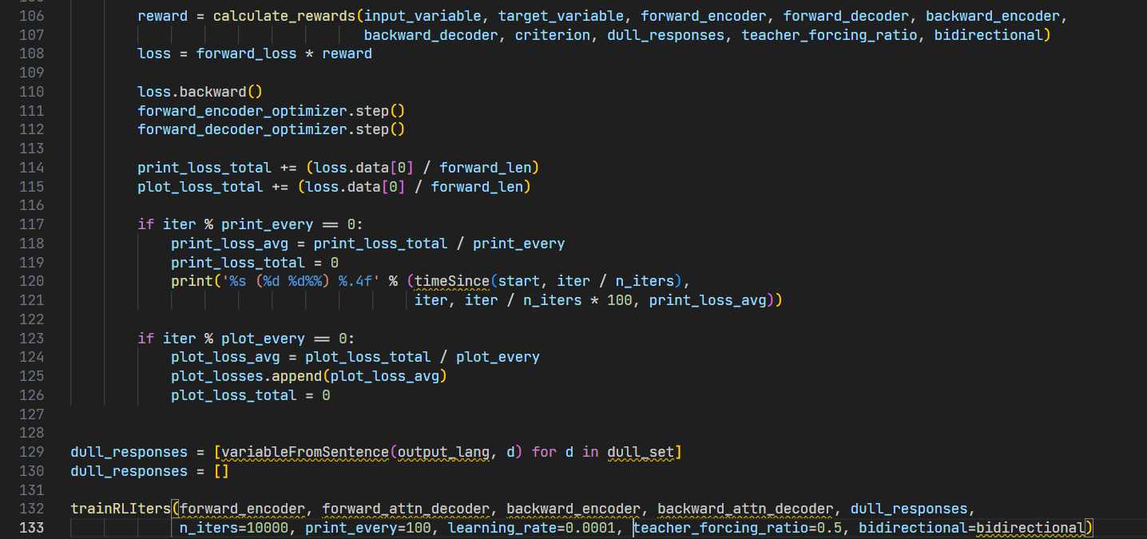

Slide 12
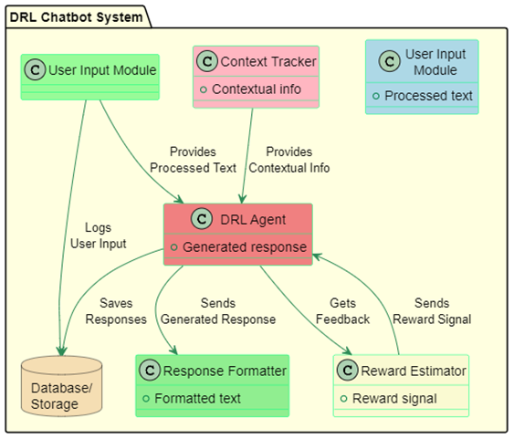
Implementation
Function module diagram
The project utilizes two encoders (forward and backward) and two decoders (forward and backward) for generating and evaluating responses. The model is trained over multiple iterations, with the model parameters being updated based on the rewards calculated from the calculate_rewards function.

Slide 13
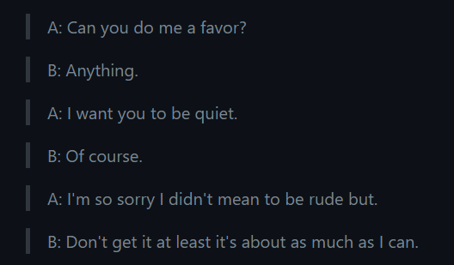
Result

Slide 14
Conclusion
This project developed a reinforcement learning model tailored for optimizing a chatbot dialogue responses, leveraging the Deep Q-Network (DQN) framework. The chatbot learns in real-time from user interactions, continually refining its dialogue responses. The inclusion of monitoring methods provides insights into the agent's learning trajectory, which is vital for fine-tuning and analysis. Overall, this research highlights the potential of deep reinforcement learning in addressing complex, real-world communication challenges in dynamic scenarios.

Slide 15
References
[1] J. Li, W. Monroe, A. Ritter, M. Galley, J. Gao, and D. Jurafsky, "Deep Reinforcement Learning for Dialogue Generation," in Proc. of the Conference on Empirical Methods in Natural Language Processing (EMNLP), 2016.
[2] B. Dhingra, L. Li, X. Li, J. Gao, Y. N. Chen, F. Ahmed, and L. Deng, "End-to-End Reinforcement Learning of Dialogue Agents for Information Access," in Proc. of the Association for Computational Linguistics (ACL), 2016.
[3] B. Liu, and I. Lane, "Iterative Policy Learning in End-to-End Trainable Task-Oriented Neural Dialog Models," in Proc. of the Annual Conference of the North American Chapter of the Association for Computational Linguistics (NAACL), 2017.
[4] M. Lewis, D. Yarats, Y. Dauphin, D. Parikh, and D. Batra, "Deal or No Deal? End-to-End Learning for Negotiation Dialogues," in Proc. of the Neural Information Processing Systems (NeurIPS), 2017.
[5] T. Wolf, J. Chaumond, and C. Delangue, "Hugging Face: Transforming Natural Language Processing with Transformers," 2019.

Slide 16
Thank You 😊

